Slide 1
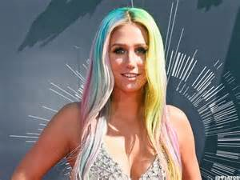
Kesha Rose Serbert

Slide 2
Informations
Kesha was Born in California the March 1 1987
She have blond or purple hair, brown eyes, beige skin and skinny we dont know

Slide 3
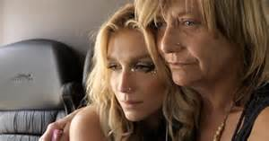
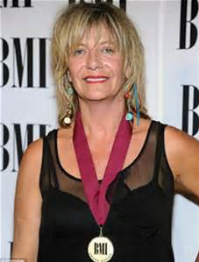
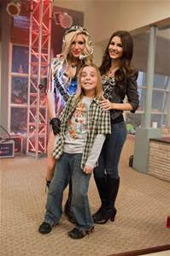
Family Member
Pebe Serbert (Mother)
Louie Serbert (Sister)
Lagan Blue Serbert (Eldest)
Hugh Moffat (Father)

Slide 4
Career Beginning
Kesha is a american singer, a songwriter and rapper
She have compose TiK ToK, Blah Blah Blah, C’Mon, True Colors and ect.

Slide 5
Favourite place
In the red carpet (this is he say in a biography)

Slide 6
Charity involvement
This charity is : PETA
Advocating for animals is second nature to me,” Kesha said in response to the honor. “My affinity with animals and the natural world inspires me and my music. I don’t understand how anyone can justify abusing or exploiting animals, and as long as it continues, I intend to keep talking about it.”

Slide 7
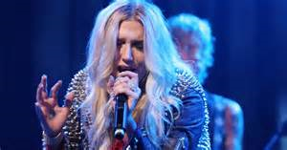
interests
The chat and the music

Slide 8
Thanks for listening!

